Slide 1
PROJECT MANAGEMENT USING ML AND OR ME 308 – Team Code: 15
Arpit Tiwari
Sumit Chandrakant Bhong
Vipul Kumar Singh
Mudit Rathore

Slide 2
Table of contents
01
Introduction
03
Formulation
02
ML Model
04
Error Analysis

Slide 3
INTRODUCTION
01

Slide 4
Problem Statement
Distributing Software issues/bugs or task in a Software firm:
This is a Project management Issue allocation problem to the various available Employees in a software company.
We want the task to be done successfully and efficiently in terms of time and also maximizing the quality.
To facilitate and augment the quality of the Project Management practice, we propose a hybrid approach that builds on the synergy between contemporary ML and OR techniques.

Slide 5
Motivation
Our main motivation was to look for a project that integrates both ML and OR in synergy and hence produce better potential outcomes.
Hybrid Approach:
ML + OR

Slide 6
Data
Machine Learning
Input
Operation Research
Output
Assignment Output

Slide 7
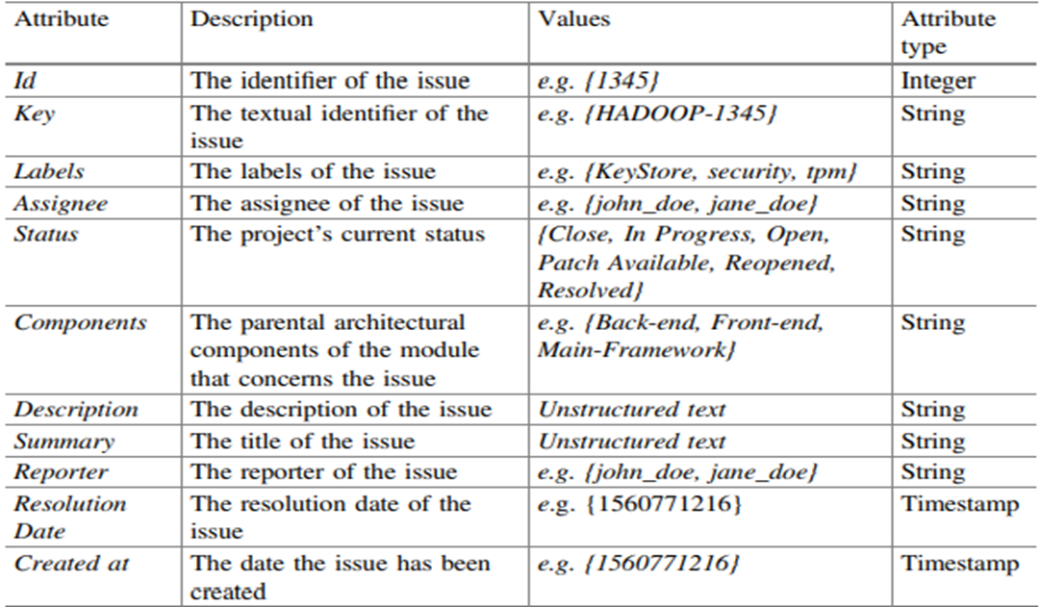
Data Attributes

Slide 8
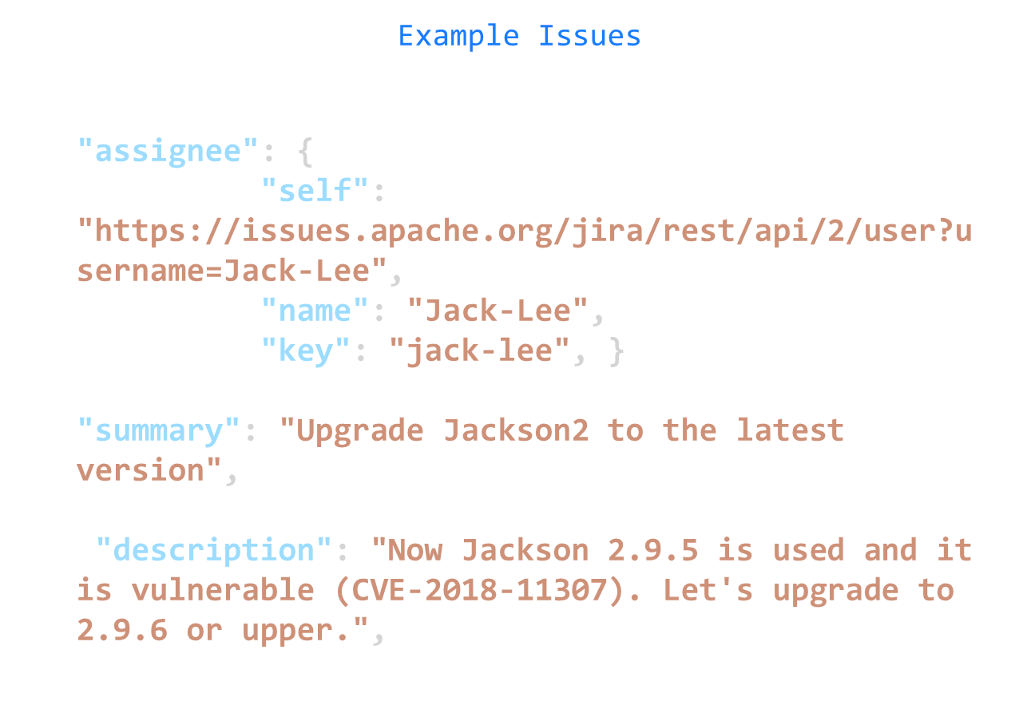

Slide 9
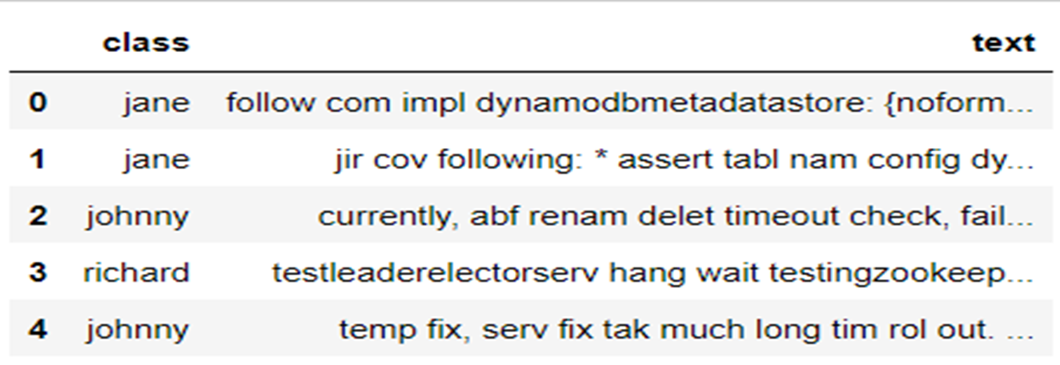
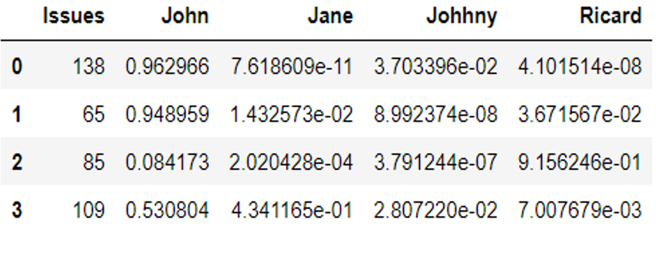
What do we need?

Slide 10
Approach
Data
Preprocessing
NLP
Final Data
Lemmatization
Stemming
Final Data
Naïve Bayes
Apply ML Classification Model
SVM
Neural Networks
Mathematical Formulation
Optimization using AMPL
Assignment
Error Analysis
Relevance matrix
OR
Notes:
For a given issue X and a developer Y, we define a relevance metric as the probability that the developer Y possesses the skills required by issue X and, consequently, his/her capability of successfully completing the issue on time . Our approach includes the following two steps:
The estimation of how relevant each developer is to undertake the issue
The assignment of developers to tasks, based on the linear assignment problem (LAP) algorithm, in a way that maximizes the total relevance metric.

Slide 11
Data Pre-processing

Slide 12
Data Cleaning / Processing
Initial data size : 1000
Removing issues which don’t have an assignee
Intermediate data size : 647
Taking statistically significant Data
Final data size : 174
Text : Summary + Description

Slide 13
Final Data in Data frame form

Slide 14
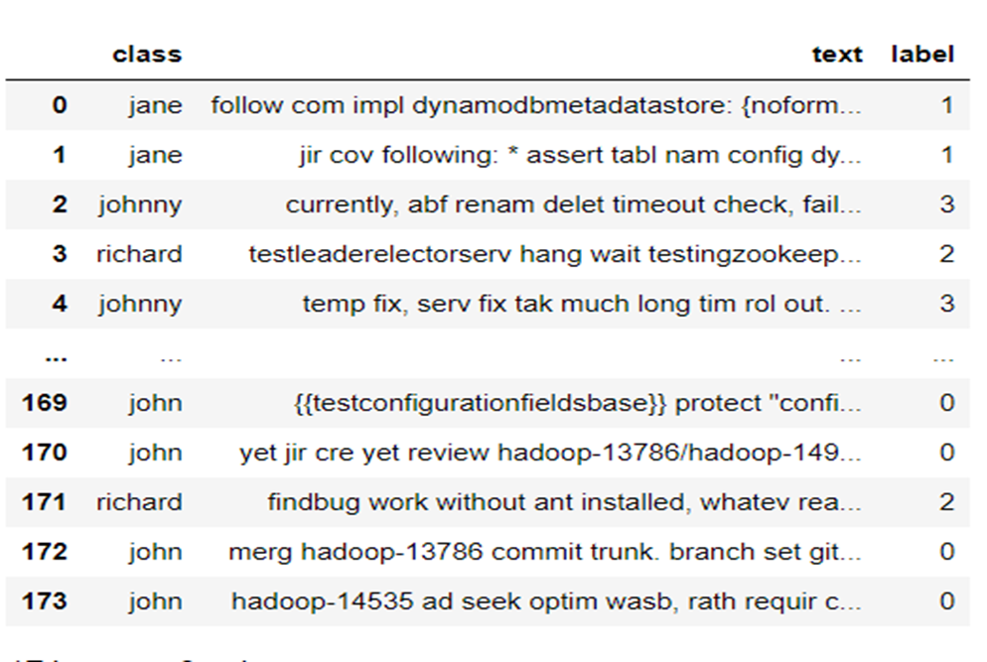
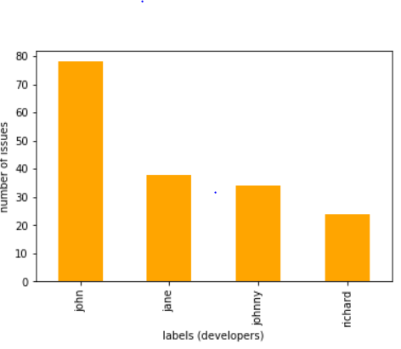
Data

Slide 15
Natural Language Processing

Slide 16
Natural Language Processing (NLP)
To extract features a variety of NLP techniques, including feature generation and text normalization, is applied to the ‘summary’ and ‘description’ given in data by:
Lemmatization
Stemming
Removal of stop words
Removal of frequently occurred words
Tokenization
Notes:
Tokenization: the process of generating tokens from unstructured text; • Lemmatization: the process of grouping together the different inflected forms of a word; • Stemming: the process of reducing derived words to their root form; • Feature/Tag generation: the process of transforming an unstructured text into a vector that contains word occurrences; • Removal of stop words: the process of removing commonly used words, which usually add noise to the ML models; • Removal of frequently occurred words: the process of removing insignificant words from a text, taking into consideration the document frequency value of each word; in our example, we remove the words with document frequency greater than 60%.

Slide 17
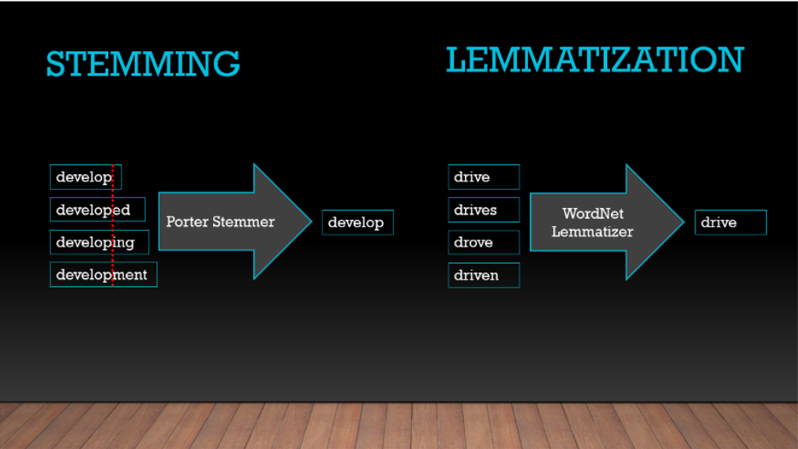
Basic Preprocessing
Lemmatization : In NLP linguistics is the process of grouping together the inflected forms of a word so they can be analyzed as a single item, identified by the word's lemma, or dictionary form
Stemming : Stemming is the process of reducing a word to its word stem that affixes to suffixes and prefixes or to the roots of words known as a lemma.
Removal of Frequent words
Count Vectorize

Slide 18
ML MODELS (Classification)
02

Slide 19
What we want ? Relevance Matrix

Slide 20
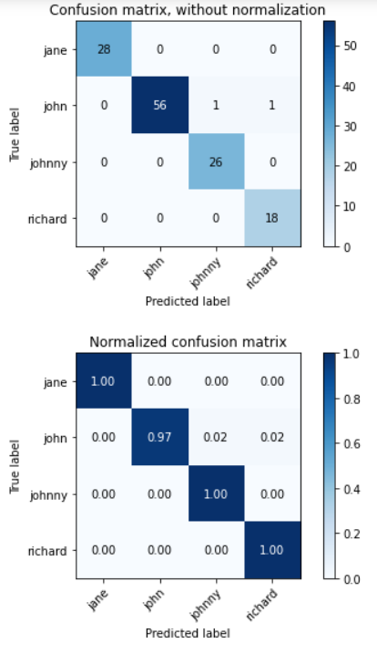
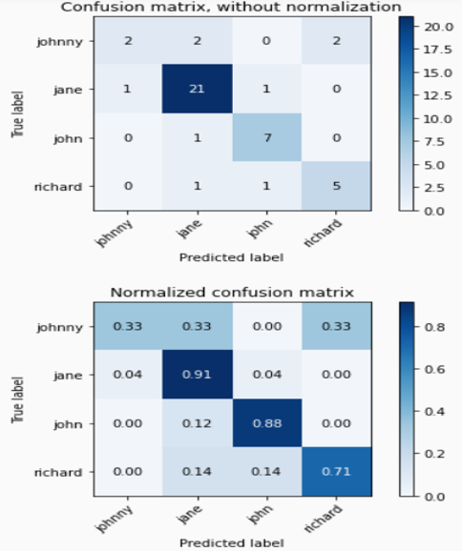
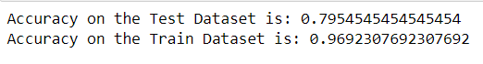
Naïve Bayes
Training Data
Test Data

Slide 21
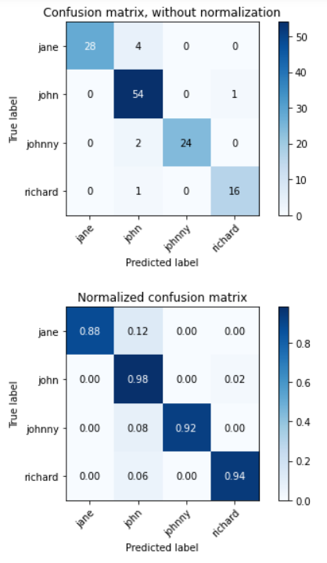
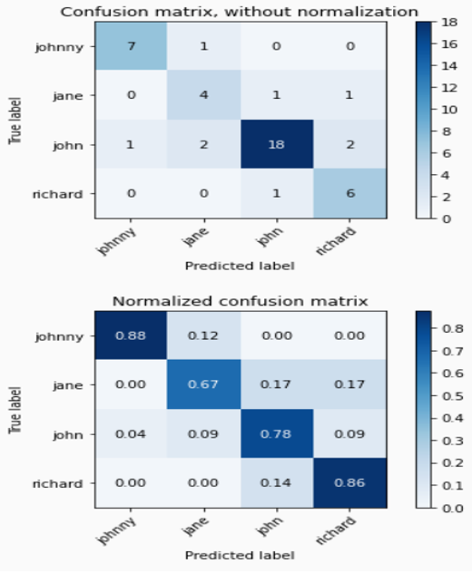
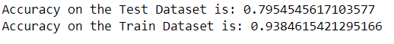
Neural Networks Based Approach
Training Data
Test Data

Slide 22
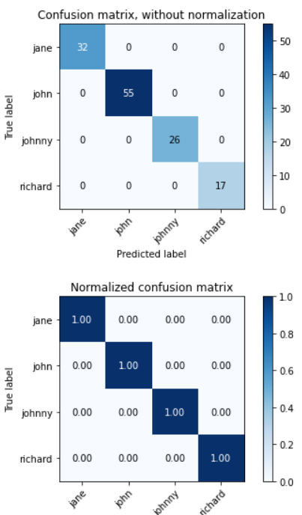
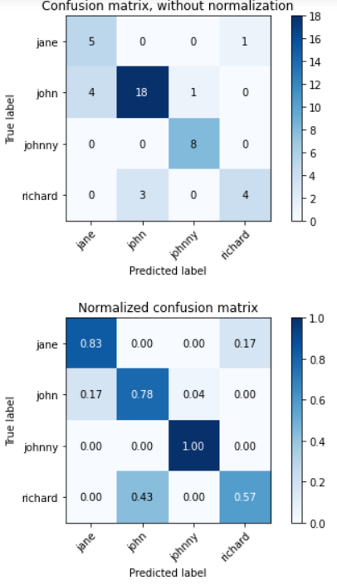
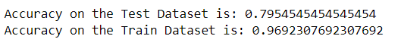
SVM (Support Vector Machines)
Training Data
Test Data

Slide 23
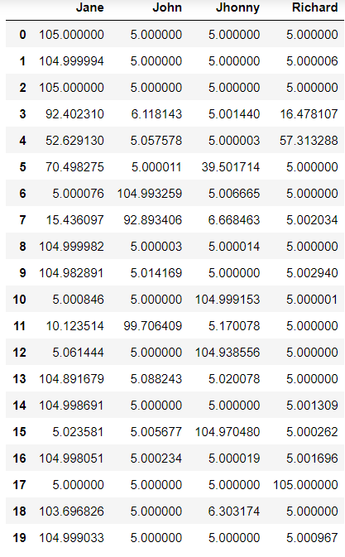
Final Relevance Matrix

Slide 24
FORMULATION
03

Slide 25

Sets and Indices:
I : set of Issues
$\left\{issue_1,issue_2,……..issue_n\right\}$
J : set of Coders $\left\{coder_1,coder_2,coder_3,……..coder_m\right\}$
i : Index in set I : i $∈I$
j : Index in set J : j $∈J$

Slide 26

Parameters :
Relevance Matrix : $R_{ij}$ $\left\{\begin{aligned}∀ i ∈I \\ ∀ j ∈J\end{aligned}\right.$
➔$This gives the relevance of coder j to solve issue i$
$Capacity of coder : Capacity \left[j\right] ∀ j∈J$
➔ $Maximum number of issues a coder j can solve$

Slide 27

Parameters :
$Time required to solve an issue : time_issue\left[i\right] ∀ i ∈I$
➔$We have randomly added time values within a certain range to$
$$model this complexity$$
$Thershold time : thresh_time\left[j\right] ∀ j∈J$
➔$Depending on the skills of coder we assign a threshold time for$
$$each coder$$
➔ A coder will solve only those issue which requires more time than threshold time

Slide 28

Decision Variable:
$$α_{ij}= \left\{\begin{aligned}1 : if issue i is assigned to coder j \\ 0 :if issues i is not assigned to coder j\end{aligned}\right.$$
$$max\left[\sum_{i=1}^{n}{\sum_{j=1}^{m}{α_{ij}×R_{ij}}}\right]$$
Objective Function : Maximize the total relevance

Slide 29

Constraints :
Capacity Constraint :
$$\sum_{i=1 }^{n}{α_{ij}} ≤Capacity \left[j\right] ∀ j∈J$$
Each issue must be assigned to only one coder :
$$\sum_{j=1}^{m}{α_{ij}=1 ∀ i ∈I }$$
$time_issue \left[i\right] ≥ α_{ij}×thresh_time\left[j\right] \left\{\begin{aligned}∀ i ∈I \\ ∀ j ∈J\end{aligned}\right.$

Slide 30
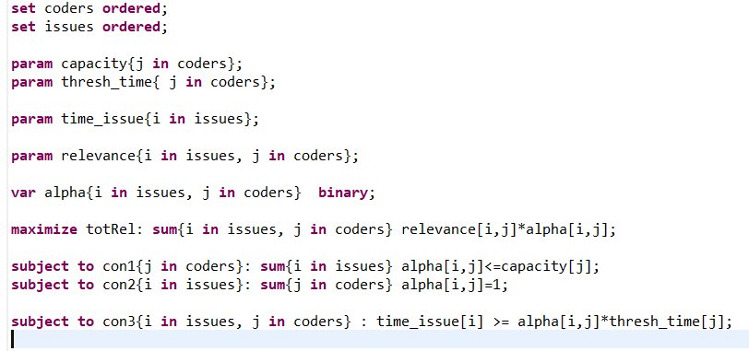
AMPL Code : (model)

Slide 31
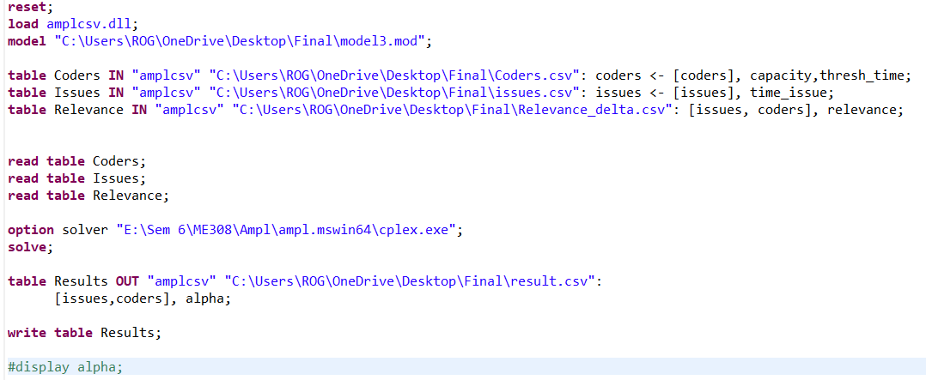
AMPL Code : (importing data and running model)

Slide 32
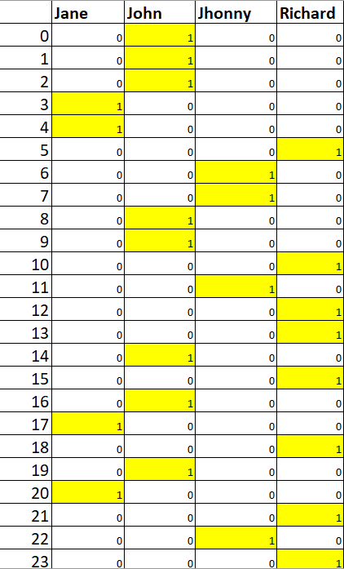
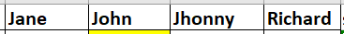
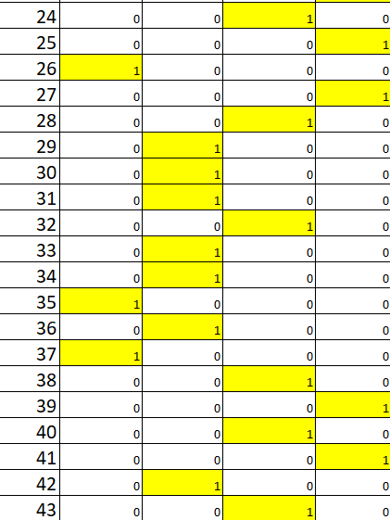
Solution : Assignment of issues
Optimum Total Relevance = 2877.10

Slide 33
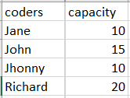
Solution :

Slide 34
ERROR ANALYSIS
04

Slide 35
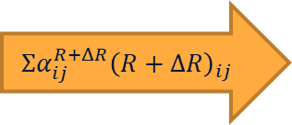
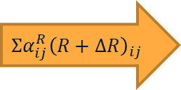
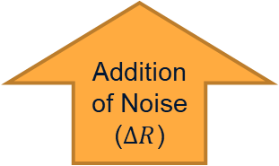
$$R+ΔR$$
𝑅+Δ𝑅
$$Solution:α(R+ΔR)$$
𝑆𝑜𝑙𝑢𝑡𝑖𝑜𝑛:𝛼(𝑅+Δ𝑅)
Relevance Matrix (R)
$$R$$
𝑅
Desired Total Relevance
$$Solution:α(R)$$
𝑆𝑜𝑙𝑢𝑡𝑖𝑜𝑛:𝛼(𝑅)
Actual Total Relevance
Optimization
$$Σα_{ij}^{R+ΔR}{\left(R+ΔR\right)}_{ij}$$
Addition of Noise ($ΔR$)
$$Σα_{ij}^{R}{\left(R+ΔR\right)}_{ij}$$
Optimization

Slide 36
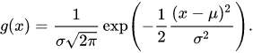


$Addition of Noise \left( ∆R\right):$
Gaussian Function :
We added the gaussian noise to original relevance matrix
$R+∆R$
% Change in relevance matrix :
We used frobenius norm to quantify the noise :
$$\frac{{\left\|ΔR\right\|}_{F}}{{\left\|R\right\|}_{F}}×100$$

Slide 37

Effect of Noise addition :
By changing the values of $σ and μ$ , we calculated optimal solution (desired total relevance) for each $R+∆R$ relevance matrix.
Also calculated the optimal total relevance ( actual total relevance) by using original solution for matrix R and calculated % error in actual total relevance and desired total relevance.
% change in Objective :
$$=\frac{\left( {Relevance}_{desired}– {Relevance}_{actual}\right)}{Relevanceactual} ×100$$

Slide 38
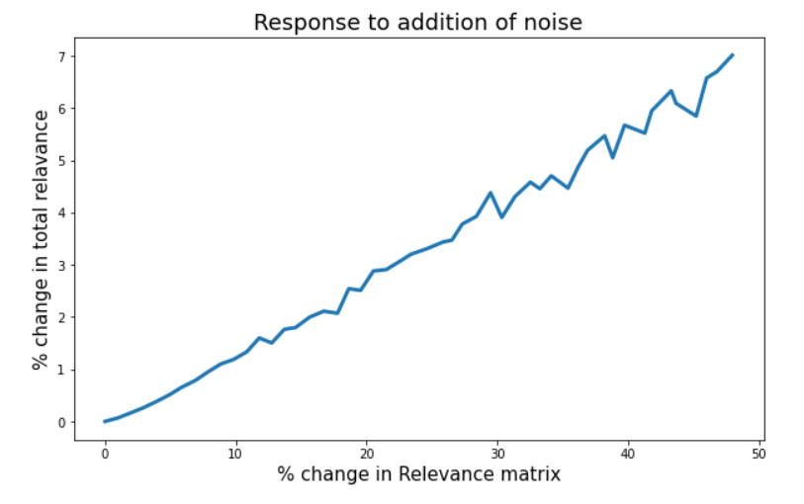

Slide 39
Where else can we use this ?
Assignment of construction works to available contractors
Assigning mentors in SOC, ITSP programme IITB
By collecting information (interests, branch, Goals) of mentees and mentors, we can find relevance matrix and then assign mentors using OR.

Slide 40
Future Work
To increase the accuracy of Relevance matrix.
Auto Assignment Problem: Adding dynamic element to our model to make it automated
If any coder is not available at given time then we need to optimize the assignment by considering only available coders.

Slide 41
Thank You!

